Slide 1
Disunion
The American Battlefield Trust

Slide 2
Inquiry Question
What is the major source of disagreement which ultimately leads to the conflict known as the American Civil War?
Notes:
Ask students to create a hypothesis of the answer to this question. Have students either discuss in groups their ideas or as a class. Ask students how they produced those hypothesis.

Slide 3
Vocabulary
Federal Government – The central government for the entire country. In the United States each state has its own government, and each state is also a member of the ‘union’ in the country. As a member of the Union all the states and its citizens must abide by the laws of the central or federal government.
Constitution – A document listing the main ideas of how a country is run and organized. The United States Constitution lists how the government works and what rights are allowed to the federal government and citizens.
Compromise – An agreement between two or more people or groups of people. Usually neither side is totally happy, but it is a way to agree on how to move forward.
Territory – land that is part of a country, but not yet organized into a state with laws and representation in the federal government.
Tariff – the cost of goods or services that are traded over a state or national boarder.
Slavery – a human being working in any way without being paid. Usually a person in slavery is also not able to move about freely or control major events in their life.
Notes:
More terms and definitions can be found on the “Glossary of Civil War Terms” page: https://www.battlefields.org/glossary-civil-war-terms

Slide 4
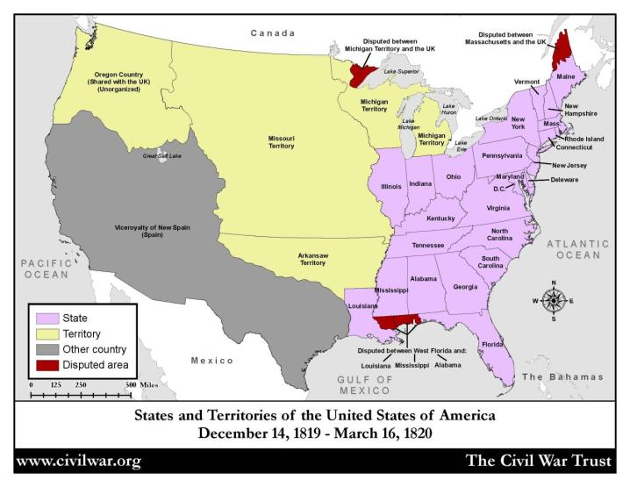

Westward Expansion
Watch
Westward Expansion 1790-1861

Slide 5
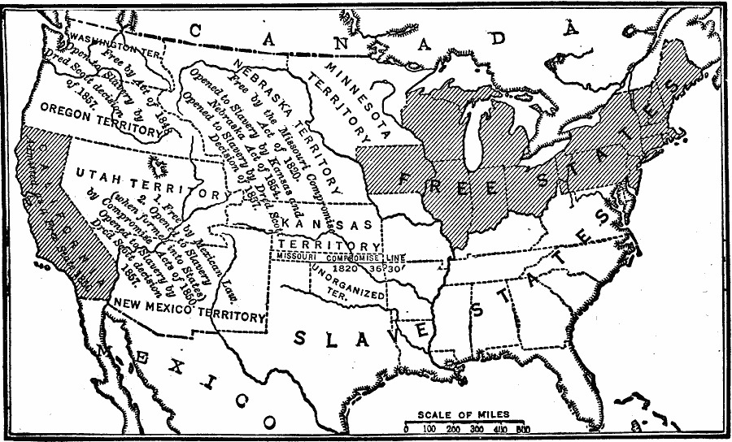
Westward Expansion
According to the Missouri Compromise of 1820, what can you expect to occur with the territories above and below 36⁰30’?
Notes:
Discuss:
According to the Missouri Compromise of 1820, what can the students expect to occur with the territories above and below 36⁰30’?
Map Credit:
Robert Hall, Harriet Smither, and Clarence Ousley, A History of the United States (Dallas, TX: The Southern Publishing Company, 1920) 308. Courtesy the private collection of Roy Winkelman. Retrieved February 11, 2011, from http://etc.usf.edu/maps/pages/5200/5289/5289.htm

Slide 6
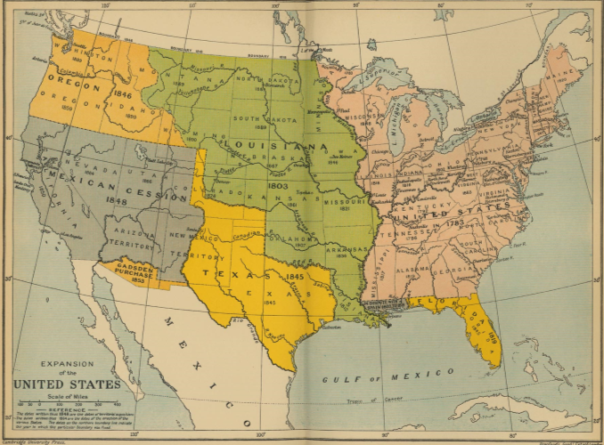
The United States in 1848
Compromise of 1820
  Maine = free state
  Missouri = slave state
  Land west of 36°30′ parallel = free states
Notes:
Explain that as new territories become states, the balance between Northern free states and Southern slave states remained equal, although there was continued disagreements over slavery and its expansion into new territories. Neither the North or South wanted the other to have more voting power, which would come from the addition of new States.
Discuss Do you think the North and South were happy with the Compromise of 1820?
Map Credit:
Ward, Prothero, and Leathes, The Cambridge Modern History Atlas (New York, NY: The Macmillan Company, 1912). Courtesy the private collection of Roy Winkelman. Retrieved February 11, 2011, from http://etc.usf.edu/maps/pages/7400/7488/7488.htm

Slide 7
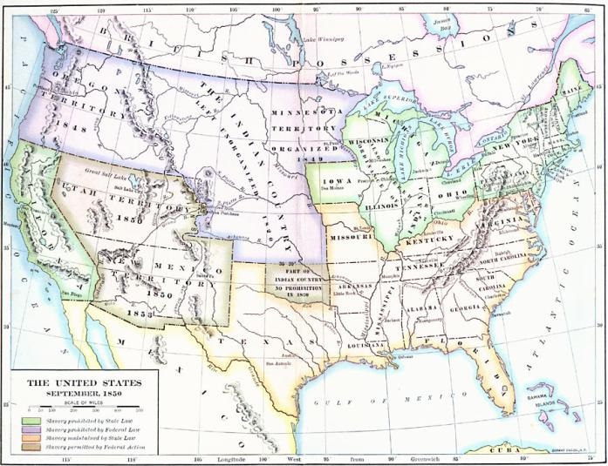
United States in 1850
Compromise of 1850
  Stricter Fugitive Slave Law
  Slavery remains in D.C
  California = free state
  New Mexico and Utah territories can personally rule on free vs. slave status
  Texas’s borders = slave state (borders redefined)
Notes:
Explain: The Compromise of 1850 overrode the Compromise of 1820. Instead of all States north of the 36⁰30’ being free and south of this line being slave, New Mexico and Utah could decide on whether they wanted slavery or not. Because of this decision, would all future territories be able to decide their slave status? In 1854, Kansas and Nebraska want to join the Union. The US government needs to decide if Kansas and Nebraska should enter as free or slave states.
Discuss How should the government decide if Kansas and Nebraska should be a slave or free state? Should they follow the Compromise of 1820 or the Compromise of 1850?
Map Credit:
Albert Bushnell Hart, LL.D., The American Nation Vol. 18 (New York, NY: Harper and Brothers, 1907) 6. Courtesy the private collection of Roy Winkelman. Retrieved February 11, 2011, from http://etc.usf.edu/maps/pages/2900/2906/2906.htm

Slide 8
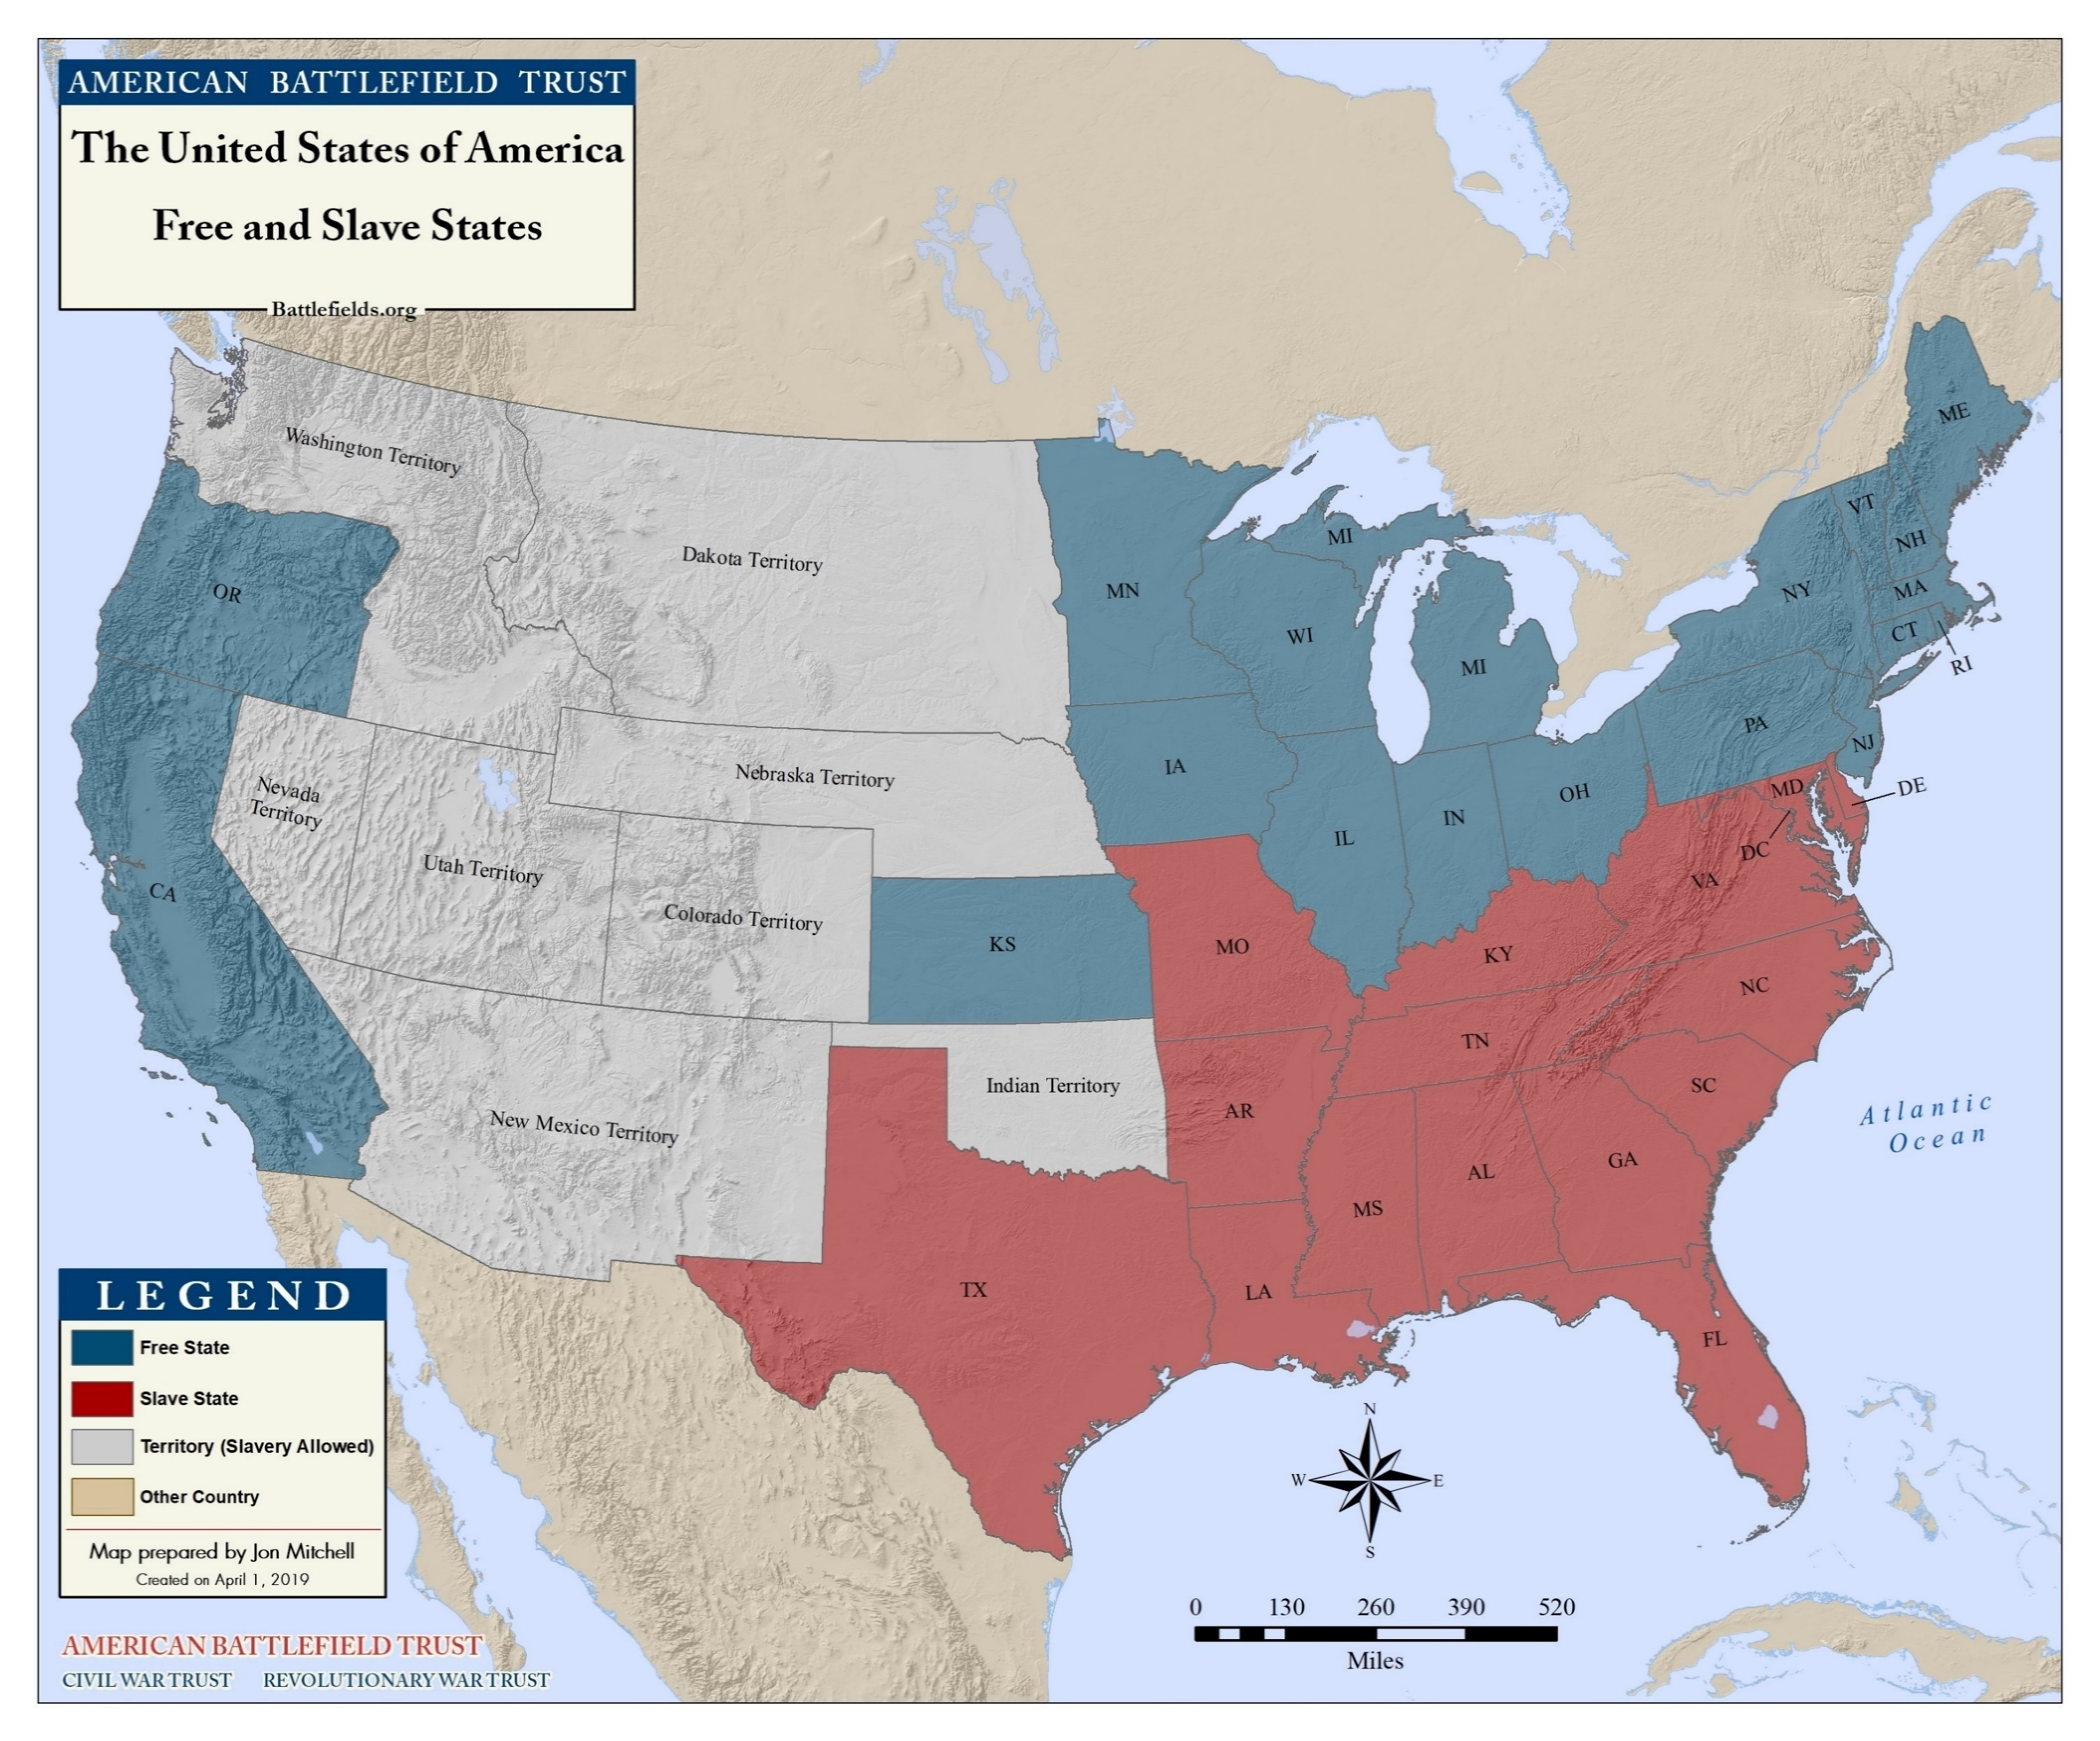
Westward Expansion
Notes:
Slavery, and its continual existence, was debated when new territories and states entered the Union. Each compromise did not definitely answer which territories would allow slavery and which territory would not. With more unclaimed land, this question would continue to be discussed.
Map depicts free and slave states on the onset of the American Civil War (1861). Missouri, Kentucky, Maryland, Delaware, and (later) West Virginia were “border states” that allowed slavery but fought with the Union. Utah and New Mexico had not yet entered the Union.

Slide 9
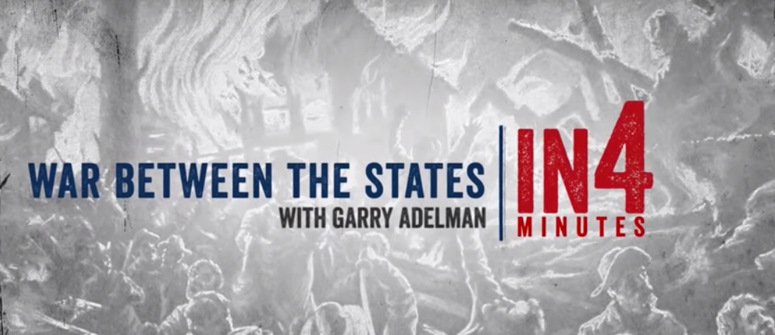
Civil War in4: The War Between the States
Watch:
Civil War in4: The War Between the States
Notes:
Video can be stopped at minute 2:19 or can be watched until the end.

Slide 10
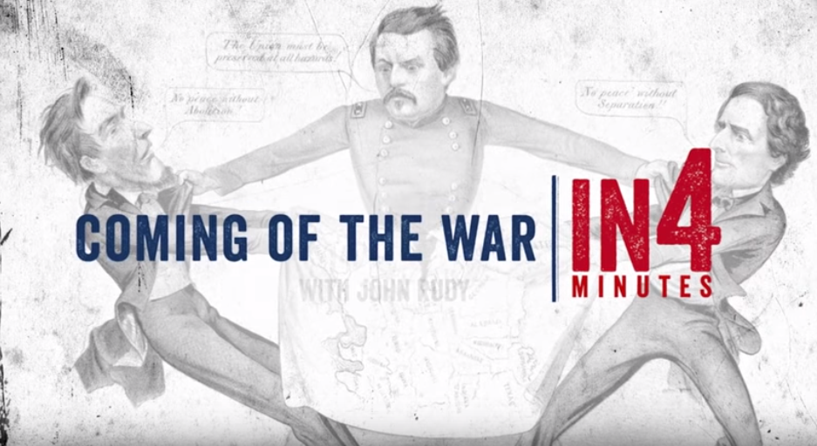
Civil War in4: Coming Into War
Watch:
Civil War in4: Coming into War

Slide 11
Major Events Prior to the War

Slide 12
Timeline of Major Events
1820 – Territorial Compromise, Missouri Compromise
1850 – Territorial Compromise, Fugitive Slave Act
1852 – Uncle Tom’s Cabin is Published
1854 – Kansas-Nebraska Act
1856 – The Caning of Charles Sumner
1857 – Dred Scott Supreme Court Case
1859 – John Brown’s Raid

Slide 13
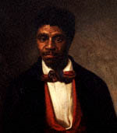
Dred Scott
1857
Scott was a slave who sued for his freedom based upon his extended residence, with his master, in the free states of Illinois and Wisconsin.

Slide 14
Dred Scott
Supreme Court Decision
“They [African Americans] are not included, and were not intended to be included, under the word ‘citizens' in the Constitution, and can therefore claim none of the rights and privileges which that instrument provides for and secures to citizens of the United States.”
“…the act of Congress which prohibited a citizen from holding and owning property [slaves] …north of the line therein mentioned is not warranted by the Constitution and is therefore void…”
Chief Justice Roger Taney, Majority Opinion
Notes:
Discuss How did you think certain groups of people respond to this verdict? Southern plantation owners? Northern abolitionist? Free African Americans? Enslaved African Americans? Do you think this decision would divide these different groups of people?

Slide 15
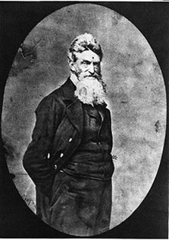
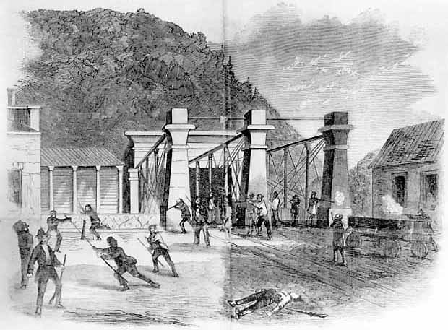
John Brown’s Raid
Harper’s Ferry, VA
October 1859
Notes:
On the evening of October 16, 1859 John Brown, a staunch abolitionist, and a group of his supporters left their farmhouse hide-out en route to Harpers Ferry. Descending upon the town in the early hours of October 17th, Brown and his men captured prominent citizens and seized the federal armory and arsenal. Brown had hopes that the local slave population would join the raid and through the raid’s success weapons would be supplied to slaves and freedom fighters throughout the country.

Slide 16
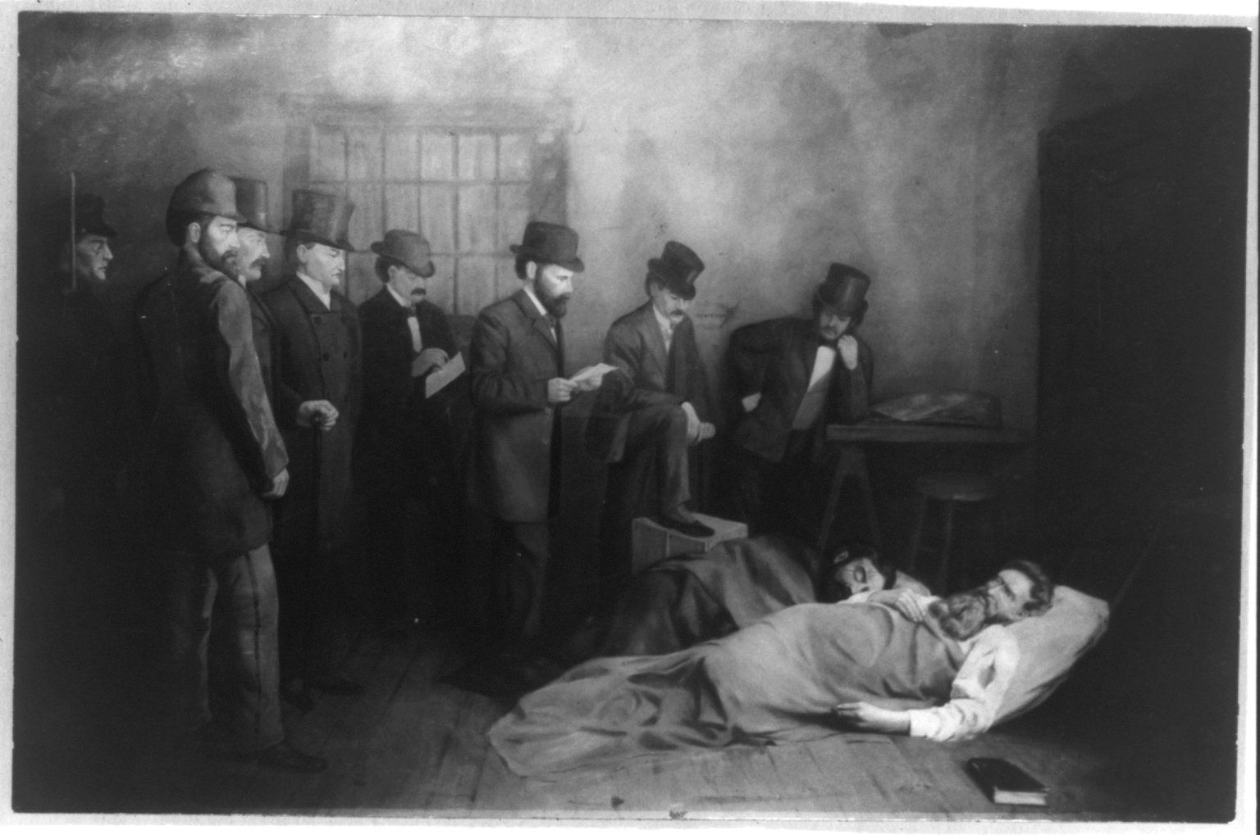
“I, John Brown, am now quite certain that the crimes of this guilty land will never be purged away but with blood.”
Notes:
Brown was quickly placed on trial and charged with treason against the state of Virginia, murder, and slave insurrection. Brown was sentenced to death for his crimes and hanged on December 2, 1859.
Discuss How do you think different groups of people responded to this raid? Southern plantation owners? Northern abolitionist? Free African Americans? Enslaved African Americans? Do you think the South would be worried about the violence of this Raid? Do you think Northerners would agree with John Brown?

Slide 17
Inquiry Question
What is the major source of disagreement which ultimately leads to the conflict known as the American Civil War?
Notes:
Discuss with the students on whether their hypothesis were correct or not. Discuss what the students learned from their primary and secondary sources.

